Slide 1
2rd Grade
Computer Science Dept/ College of Education for Pure Sciences
Special Topics: Microprocessor & Assembly Language
Instructor: Ghazwan Abdulnabi Al-Ali
University of Basrah, Iraq

Slide 2
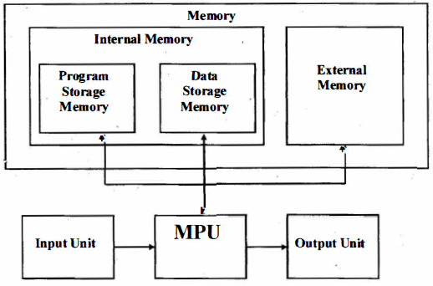
General Architecture of Microcomputer system
The hardware of Microcomputer system can be divided into four functional units:
Input Unit
Microprocessing Unit (MPU)
Memory Unit
Output Unit

Slide 3
Memory Unit
Internal Memory.
used for storage to active information and programs (program to be executed and data under processing).
ROM & RAM.
External memory
used for storage of non active data (long storage).
CD & Disk drives

Slide 4
Microprocessor
EU (Execution Unit)
(EU) Execution unit that responsible of executing instructions ..
Registers
Small and fast memory that contains the data that is under process
ALU (Arithmetic and Logical Unit)
Executing arithmetic and logical instructions
And, OR, XOR, NOT
CU (Control Unit)

Slide 5
Microprocessor
BIU (Bus Interface Unit)
BIU controls on Buses and transfers data between EU and memory and External I/0 devices.
Segment Register
Segment registers are used to control memory addressing.
2. Instruction Point
It is a register to indicate the next instruction to be executed
3. Instruction Queue
Note// EU and BIU is parallel, but BIU keeps one step forward (when EU executes an instruction BIU brings another instruction from memory and put it in instruction queue).

Slide 6
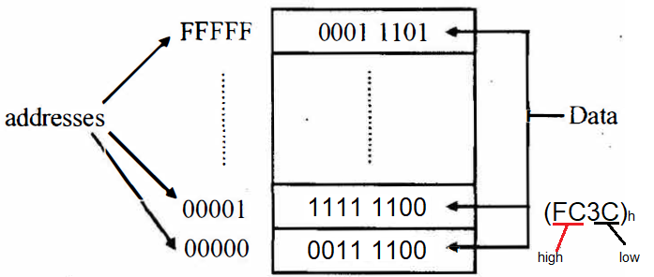
Memory address space and data organization
is organized as bytes of data stored at consecutive addresses from 00000h to FFFFFh ,
these bytes can be independently accessed.
the lower address byte is called the least significant byte and the higher address byte is called the most significant byte.

Slide 7
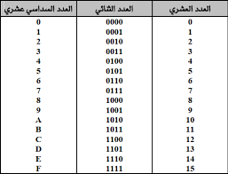
8 4 2 1
* * * *
1 1 1 1
8+4+2+1=15=F
8 4 2 1
0 1 1 0
0+4+2+0=6

Slide 8
Registers
Segment Registers
CS
DS
SS
ES
Data Registers
AX
BX
CX
DX
Indexing Registers
SI
BP
Point Registers
SP
BP
IP

Slide 9
Thank You

